Slide 1


Akole Taluka Education Society’s
TECHNICAL CAMPUS AKOLE
At / Post. Tal. Akole, Dist. Ahmednagar– 422 601, Tel. 02424 221123 / 24, Web. www.atestc.com, email- akole2011@gmail.com,
S.Y.MCA Sem - IV
“SOCIETY MANAGEMENT”
Approved by AICTE, New Delhi, Recognized by DTE, Govt. of Maharashtra and Affiliated to
Savitribai Phule Pune University, Pune
Presented by –Shubham Jadhav
Submitted to :- Sagar.S.Wakchaure

Slide 2
A PROJECT REPORT ON ‘SOCIETY MANAGEMENT’ BY SHUBHAM JADHAV SAVITRIBAI PHULE PUNE UNIVERSITY MASTER IN COMPUTER APPLICATION ATES – TECHNICAL CAMPUS AKOLE AHAMEDNAGAR- 422601 2021-2022

Slide 3
SOCIETY MANAGEMENT
Welcome....

Slide 4
INTRODUCTION

Slide 5
Company Profile.
Pawar Software Solution Pvt. Ltd is a leading global technology services provider, delivering business solutions to its customers. Pawar Software Solution Pvt. Ltd founded the information technology service provider industry more than 4 years ago. Today, as an Internet Solution Provider, Apps Techno delivers one of the industry’s broadest portfolios of information technology services to customers in the education, manufacturing, financial services, healthcare, communications, energy, transportation, and consumer and retail industries, and to governments around the world. We have developed several software ranges and today, we are taking new paths, like ERP Module, complete web and Internet promotions, SMS API Solution Consultant and many new top features.
What we offer
As our customers’ trusted business, we provide the best solutions for executives to maximize return on their IT investments. Our deep industry knowledge enables us to provide innovative ideas that help to improve productivity and security. We deliver on our commitments, so customers can build strong relationships with us, achieve profitable growth and win in the marketplace.

Slide 6
Existing System And Need Of System.
The data is stored in the files and the processing of the data is done manually and the report generation is slow.
Data which is required cannot be accessed quickly.
The data is stored in various registers so the linking between it becomes difficult.
Voting is conducted in the society for various designations like secretary, treasurer, chairman , etc members need to be present on the site for voting. Due to some reasons some members cannot be present & cast vote.
Booking a hall for celebration in a society was a difficult work which may create confusion when more than one people want to celebrate in same hall.
Generation of bills and distribute that bill manually is difficult.
It generates bill for all members at single click. And Send it to respective member.
If any security related issue is created then it gone difficult to alert society members instantly.
Using this app it get easy to alert society members instantly.

Slide 7
Scope Of The System
This is one of the mobile applications that is designed to provide facilities to the society members which can be utilized using smart phone.
This system is designed to reduce the burden form the society chairman. To manage all single details of society. So this Application will help to keep all data with very low cost.
This application will reduce paper work.
Using this application any easy to keep track of payment history.
Maintain payment slips.
Yearly , Monthly wise reports.
All type of Maintenance reminder.
We have more option such as payment.

Slide 8
Operating Environment
Hardware Requirements
1. CPU: Intel I3 or Above
2. RAM: 8Gb
3. Hard Disk: 3 GB
4. Android Device with 4.4 and above version
5. Android Emulator
Software Requirement
JDK 1.8
Apache Tomcat 7
IDE
Android Studio
C panel Or Xampp Server
Database
MYSQL
Language Used
JAVA, PHP, XML

Slide 9
Type of Mobile Application
1.Hybrid
Detail Description of Technology Used
1.Android
Android is Linux based open source operating system , it can be developed by any one
Easy access to the android apps
You can replace the battery and mass storage, disk drive and UDB option
Its supports all Google services
The operating system is able to inform you of a new SMS and Emails or latest updates.
It supports Multitasking
Android phone can also function as a router to share internet
Its free to customize

Slide 10
Can install a modified ROM
Its supports 2D and 3D graphics
Android provides a rich application framework that allows us to build innovative apps and games for mobile devices in a Java language environment.
The Android open-source software stack consists of Java applications running on a Java-based, object-oriented application framework on top of Java core libraries running on a Dalvik virtual machine featuring JIT compilation.
This App is compatible with version 4.4 kitkat above version.

Slide 11
2.XML
sing Android's XML vocabulary, you can quickly design UI layouts and the screen elements they contain, in the same way you create web pages in HTML — with a series of nested elements.
Each layout file must contain exactly one root element, which must be a View or View Group object. Once you've defined the root element, you can add additional layout objects or widgets as child elements to gradually build a View hierarchy that defines your layout. For example, here's an XML layout that uses a vertical LinearLayout to hold a TextView and a Button.
After you've declared your layout in XML, save the file with the .xml extension, in your Android project's res/layout/ directory, so it will properly compile.

Slide 12
3.PHP
PHP is an acronym for "PHP: Hypertext Pre-processor“.
PHP is a widely-used, open source scripting language.
PHP scripts are executed on the server.
4.HTML
HTML is the standard markup language for creating Web pages.
HTML stands for Hyper Text Markup Language.
HTML describes the structure of Web pages using markup.
HTML elements are the building blocks of HTML pages.
HTML elements are represented by tags.
HTML tags label pieces of content such as "heading", "paragraph", "table", and so on.
Browsers do not display the HTML tags, but use them to render the content of the page.

Slide 13
The <!DOCTYPE html> declaration defines this document to be HTML5.
The <html> element is the root element of an HTML page.
The <head> element contains meta information about the document.
The <title> element specifies a title for the document.
The <body> element contains the visible page content.
The <h1> element defines a large heading.
The <p> element defines a paragraph.
5.SQL
SQL is a standard language for accessing and manipulating databases.
What is SQL?
SQL stands for Structured Query Language.
SQL lets you access and manipulate databases.
SQL is an ANSI (American National Standards Institute) standard.

Slide 14
Proposed System.

Slide 15
Problem Statements
The manual system is very complex to be managed and searching or updating the information. The main problem is to edit the manage performance of app to all android device.
Product Position Statement
System Helps to manage all society details and their event and payment details and all member’s data. provides more functionality that keep all data available by 24*7*365 any where without any cost. And It will provide huge amount of data to all member of society to check complete society account details. Like expenses pending amount.
Product Overview
The society has required a system that maintains their data as well as keeps the record of the how many people are in our society. This software manage all information about members ,their payments data, all expenses of society and their receipt. That all accessible by all members of the society. It will provide pending society amount detail and bill of the society.etc.

Slide 16
Summary Of Capabilities
This software manage all information about society members etc. it also store daily information of expenses and income, and pending amount. Which is handled by admin. Also information about society members and comity members, This Provide all details to all members of society like society payment, pending society amount. All member details.
Assumptions And Dependencies
The registration of the member’s is managed by the Administrator.
The Members, Admin must have proper login id and password so that only authorized have proper access to the system.
Objectives Of Proposed System
Provide secure login to admin and the members.
It helps the society secretary to handle and manage flat owners data.
It helps them manage society funds.
It brings transparency and efficiency in the working of housing societies
User can easily use the application.
This application allows us to access data from anywhere within click.
It keep the track of each payment details.

Slide 17
It provide username and password to all members
Admin can add users, and manage all members details.
Admin can create the society amount and respite after receiving payment.
Admin can also create the prescriptions.
Also Maintain short report.
Reduces human-efforts.
App is Available for 24*7 and its free.
It is easy to understand and use and also reusable.
Graphical and colourful interface.
It Save mobile data which reduce cost.
No Errors in effect on other data.
Easily recover password.
Ability to store all expenses and income details .
Its store lots of form data.
Accuracy and Quality presentation can be achieved

Slide 18
User Requirements
The users have sufficient knowledge of computers.
The users know the English language, as the user Interface will be provided in English.
The registration of the Members is managed by the admin.
The Members must have login id and password so that only authorized have proper access to the system.
Members and their data are stored in centralized database.
In this Application, admin can handle all the event or transaction of payment history of all society users.
All society members has their own ID password. All members can get all payment history and all members details
Admin allow to add & remove amount from members if necessary & user will get information about that activity.

Slide 19
User can change account password easily, without admin permission .
The higher authority is responsible for updating database with proper information. With the help of this system, communication is carried out through notifications between customer and higher authority of system.
With proper login, it will not have misused by external or other person.
With the help of this site authorised member can login and verify as per the login ID stored in database.
The backup of the database must be stored by the administrator.

Slide 20
Analysis And Design.

Slide 21
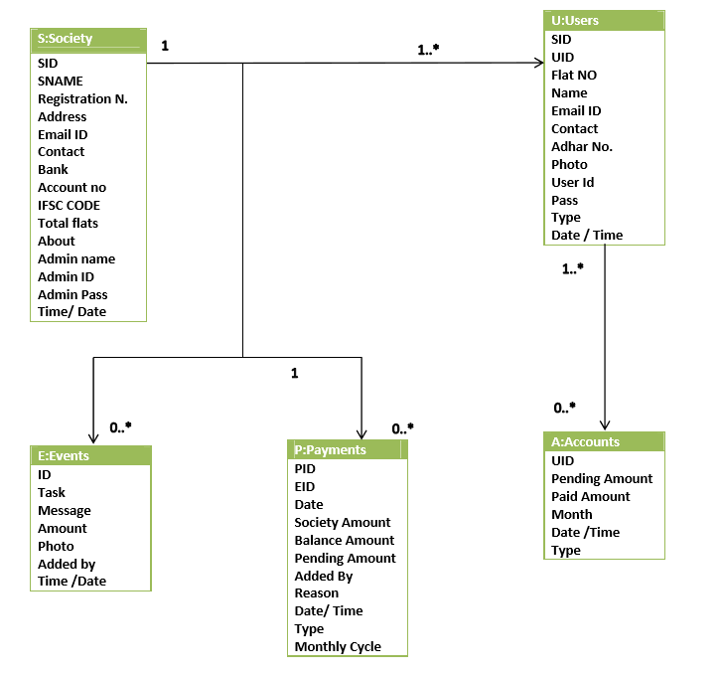
Object Diagram

Slide 22
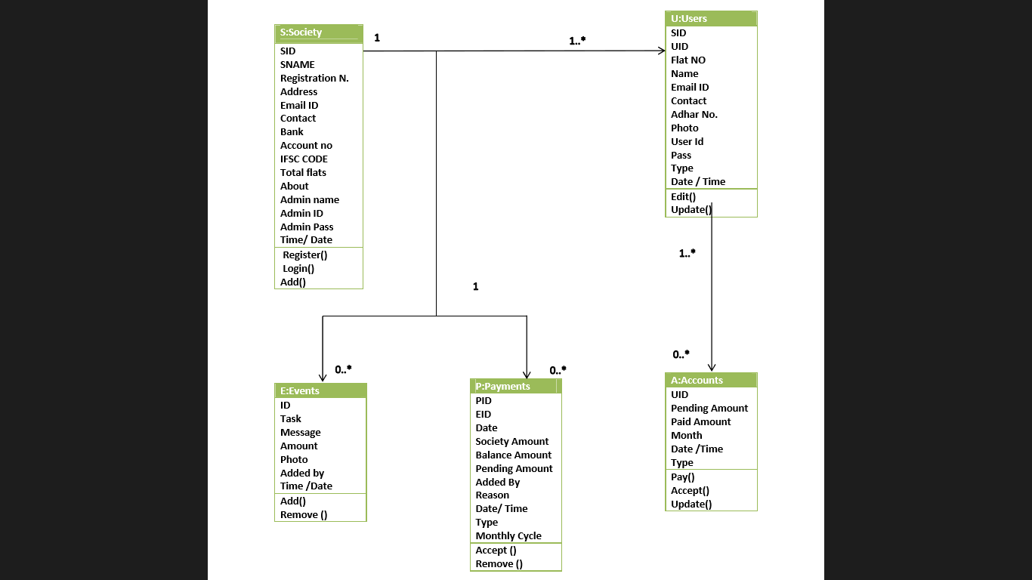
Class Diagram

Slide 23
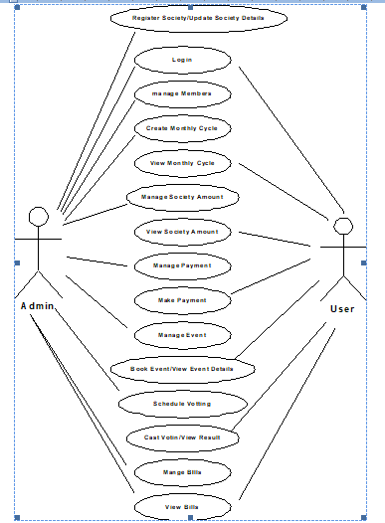
Use Case Diagram

Slide 24
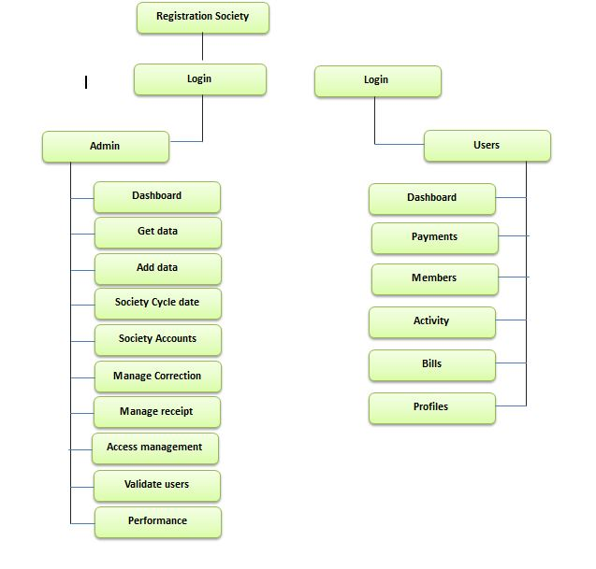
Module Hierarchy Diagram

Slide 25
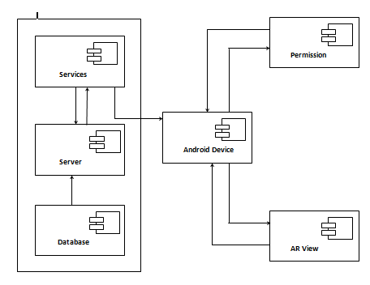
Componenet Diagram

Slide 26
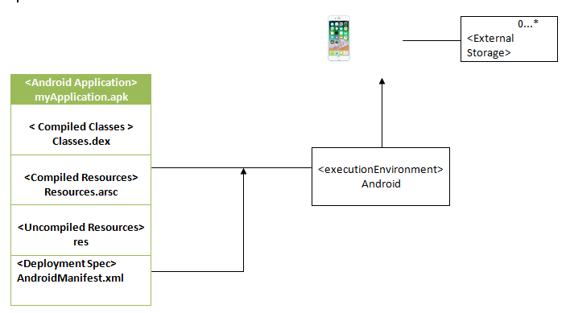
Deployment Diagram

Slide 27
User Interface Design.

Slide 28

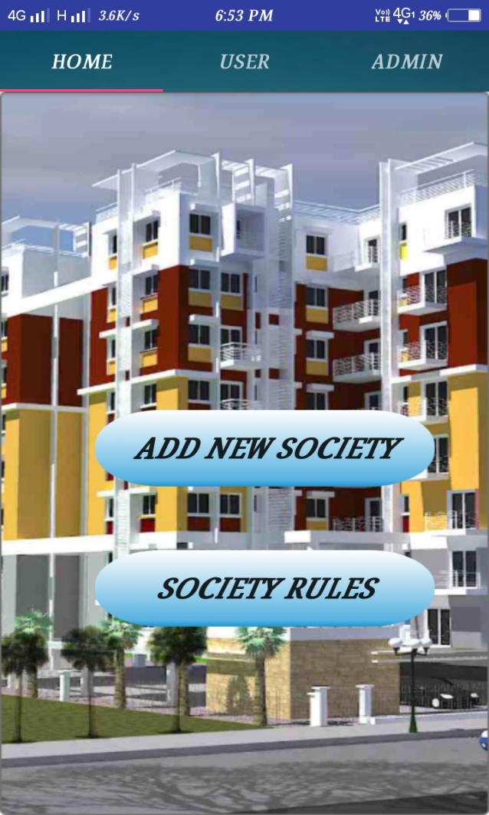

Slide 29
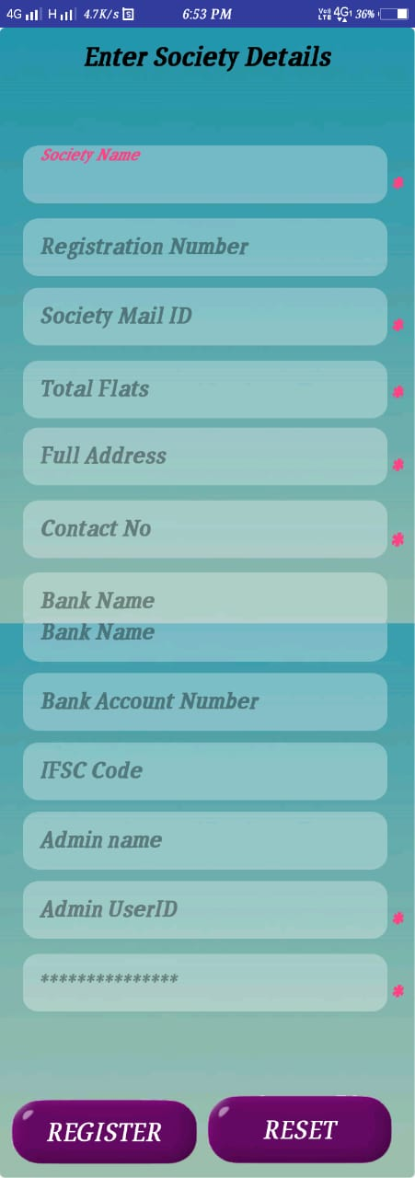
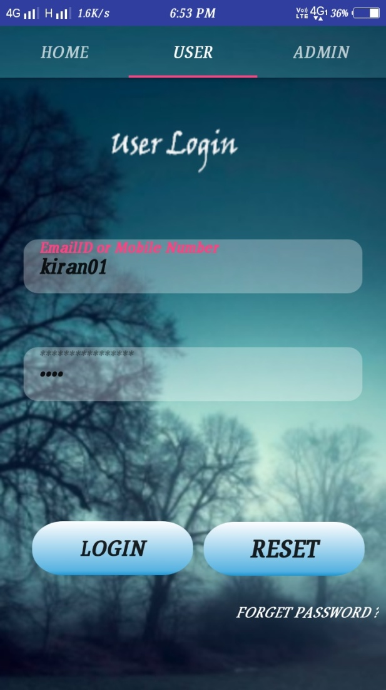

Slide 30
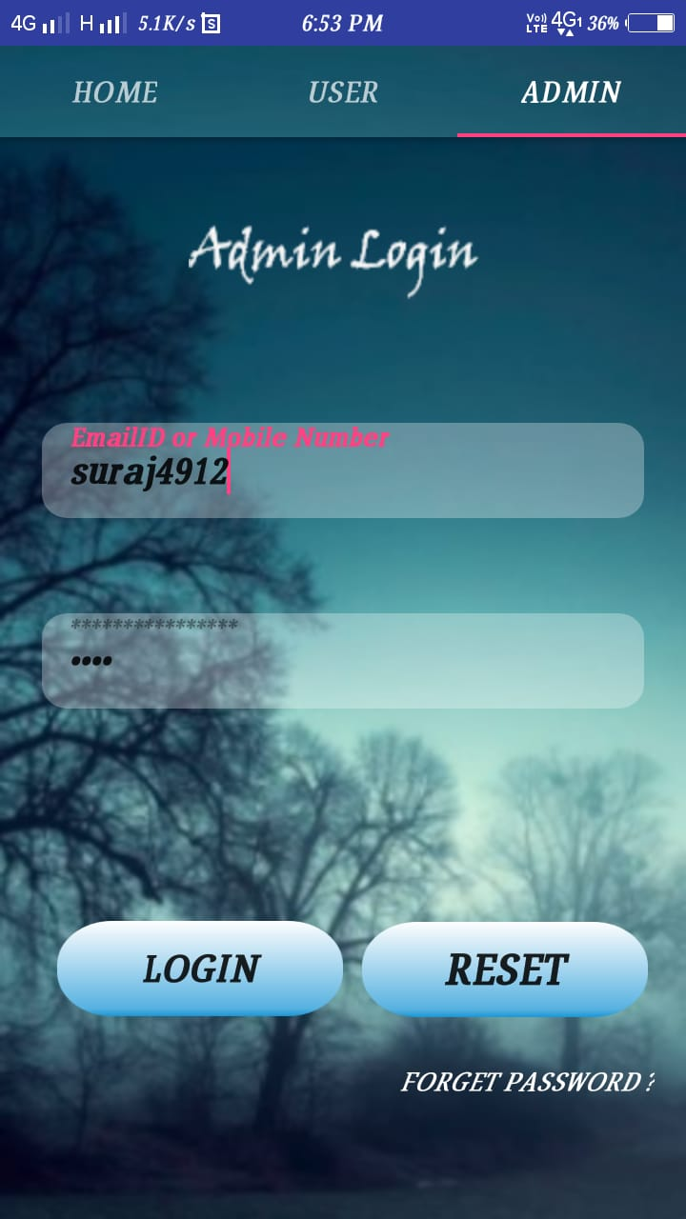
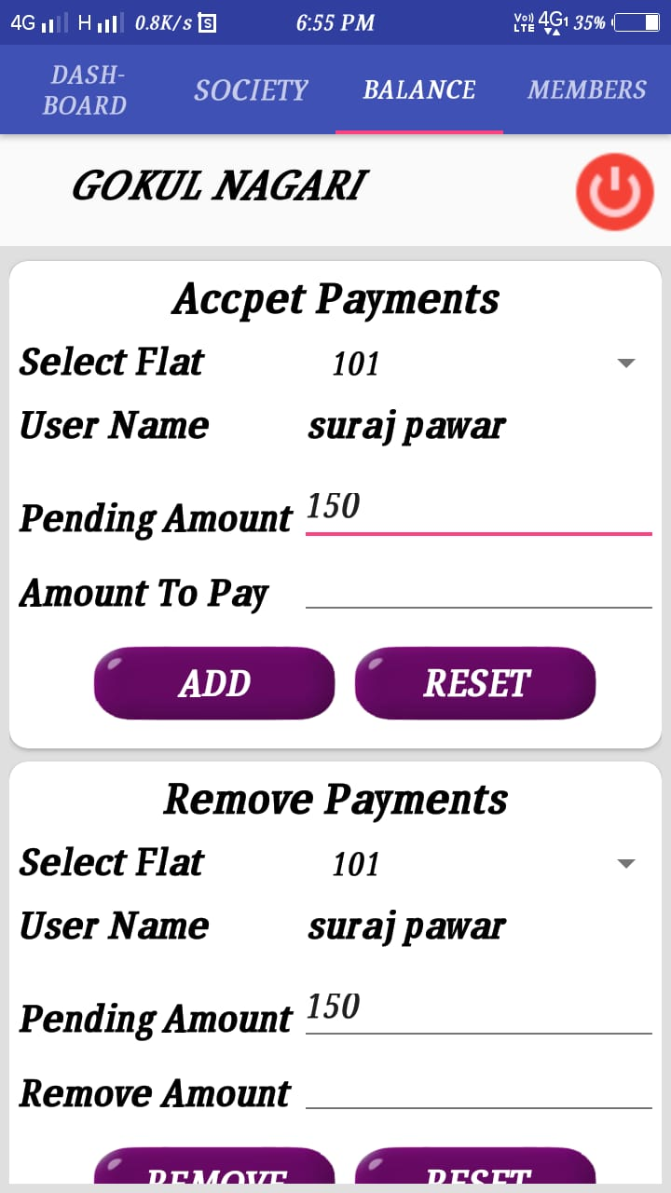

Slide 31
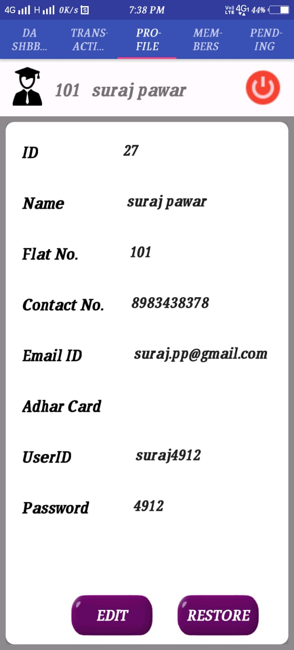
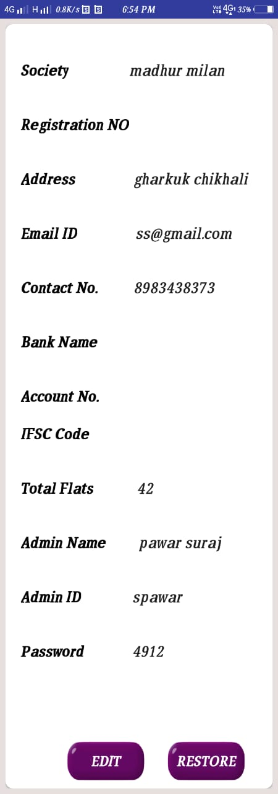

Slide 32
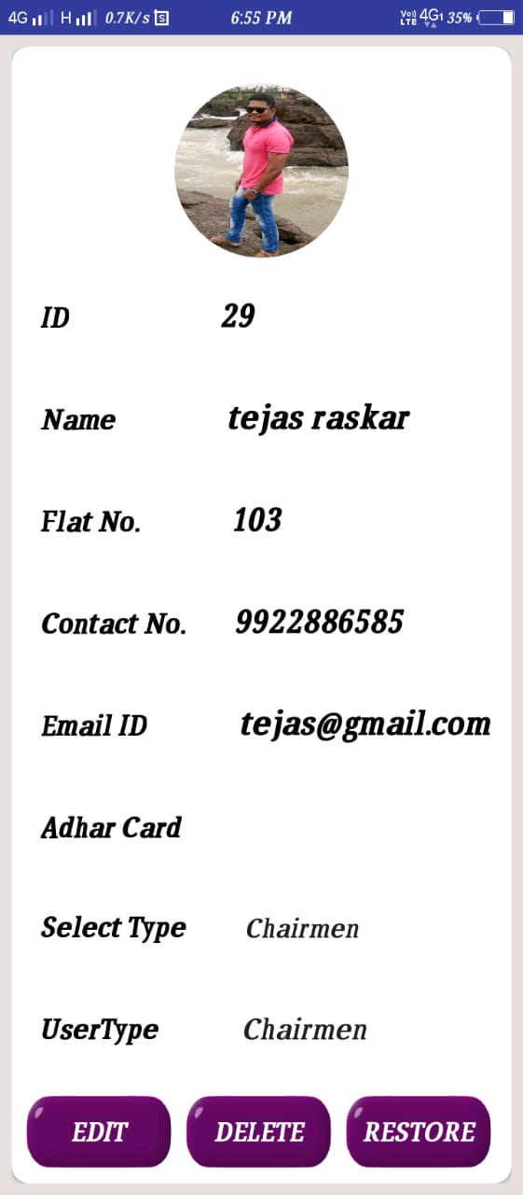
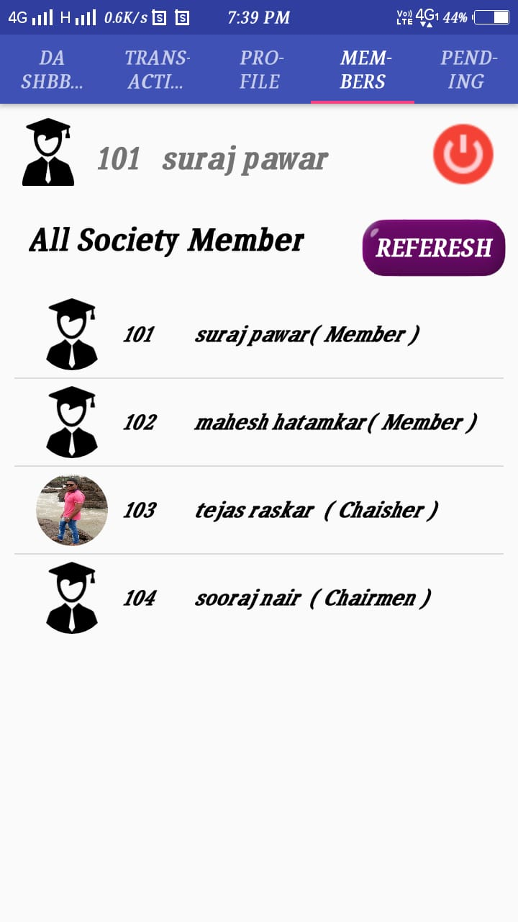

Slide 33
Table Specification.

Slide 34
Society
Attribute Name | Data type and size | Constraints | Description
soid | int(11) | Primary key (Auto Increment) | Society id
so_name | varchar(30) |  | Society name
So_register_no | varchar(30) |  | Registration no
So_address | varchar(12) |  | Society address
So_email | varchar(50) |  | Email id
contact | varchar(40) |  | Contact
Bank_name | varchar(50) |  | Bank Name
Bank_acc | varchar(30) |  | Bank Accounts
IFSC_code | varchar(3000) |  | IFSC Code
Tot_flats | varchar(5000) |  | Total Flats
Admin_name | varchar(50) |  | Admin Name
Admin_id | varchar(300) |  | Admin id
Admin_pass | varchar(5000) |  | Admin Password
Save_time | varchar(100) |  | Time
Save_date | Varchar(100) |  | Date

Slide 35
Society Members
Attribute Name | Data type and size | Constraints | Description
suid | int(11) | Primary key (Auto Increment) | Profile photo id
Soc_id | int(10) | Foreign key | Society Id
Flat_no | varchar(5000) |  | Flat No
Name | varchar(4000) |  | Name
Contact_no | varchar(12) |  | Contact No
Email_id | varchar(1000) |  | Email id
Adhar_card | varchar(10000) | Foreign key | Aadhar card
Userid | mediumtext |  | User id
pass | varchar(100) |  | Password
photo | varchar(100) |  | Photo
Save_time | varchar(100) |  | Time
Save_date | varchar(100) |  | Date
User_type | varchar(100) |  | User Type

Slide 36
Society Events
Attribute Name | Data type and size | Constraints | Description
ID | int(11) | Primary key (Auto increment) | Event id
task | Varchar(100) | Foreign key | Task
msg | varchar(5000) |  | Event Description
Amount | int(11) |  | Spend Amount
Photo_path | varchar(100) |  | Bill Image
Added_by | varchar(100) |  | Added by Admin ID
Save_time | varchar(100) |  | Time
Save_date | Varchar(100) |  | Date

Slide 37
Photo
Attribute Name | Data type and size | Constraints | Description
Pid | int(11) | Primary key(Auto increment) | photo friend id
Photo_name | Varchar(100) |  | Photo Path

Slide 38
Society Payments
Attribute Name | Data type and size | Constraints | Description
Pid | int(11) | Primary key(auto increment) | Frnd no
Id | int(11) |  | Self id
Date | int(11) |  | Date
Society_amt | varchar(30) |  | Society Amount
Balance_amt | varchar(100) |  | Balance Amount
Pending_amt | varchar(100) |  | Pending Amount
Added_by | varchar(100) |  | Added By Admin ID
Added_for | varchar(100) |  | Added for Reason
Save_time | varchar(100) |  | Time
Save_date | varchar(100) |  | Date
Type_main | varchar(100) |  | Maintaince Type
monthlyCycle | varchar(100) |  | Monthly Cycle

Slide 39
User Manual.

Slide 40
Admin
Admin must Register with Society Details then Admin will get ID n password.
After Successful Registration and Login Admin will get Dashboard.
their add all society members and their Details.
After successful added members go for Monthly cycle date and monthly society Amount in Society Tab. Admin will get changes on same window.
If admin want to Accept any members payment go for Payment Tab.
Then select flat no. and Accept Payment.
Admin can Upload Society Expenses bill of any Event to share with all society member to add event go for Dashboard and add Event their.
Admin Can Update any society Members profile except Profile Picture.

Slide 41
Users
After Society Registration, Admin will provide userId and password. Login with Id & pass.
users has only read only access through out application user able to see all society Expenses and events. Also user can contact details of all society Member.
After Payment user will get Digital receipt of Payment. In Transaction Tab.
User Can Change user Id & Password easily without admin permission.
User Can get Pending Amount of All society members.

Slide 42
Operations Manual
Admin Process
Step 1 : Turn on internet then open application.
Step 2: Click on Add new society Button.
Step 3 : Fill all details with * marks and hit Register Button. And Remember that admin ID & Password.
Step 4 : Login with admin ID and Password .
Step 5: After Successful Login. Click on Members Tab and click on Add Button to add society members.
Step 6: Now add Monthly Cycle Date, to add Click on last update & choose date from calendar and fill monthly maintenance amount.& click on Add Society Button to add amount to all members account.
Step 7: To Accept Society Payment go to Balance Tab. Select Flat no and Enter Amount to paid by Member. & To revert payment Use Second Option “Remove Payments” enter amount and click Remove.
Step 8: To add any Society Activity. Visit Dashboard Tab and click on Add Activity Tab. And Fill form and click on Submit to add Activity.

Slide 43
Step 9. Incase Of update Society Details (Change Address ,Name ,Account no. etc.) You can change by Click on Society Name as Shown below.
Step 10. In case of manual Change in Society Payment Details. Click as shown below.
Step 11: Incase of Update Member Any Members Details refer below Screenshots. We can Delete Member also from society (Delete will not revert back before adding amount in society members account you can delete members).
Step 12: To check Payment History of Members.
2.User Process
Step 1: Get User ID & Password from admin & login.& follow below steps to use.
Step 2: Log in in to user section.
Step 3: Click on dashboard to see all the Balance amount and pending amounts.
Step 4: Click on Transaction tab to see all Transactions History.
Step 5: Click on Profile tab to see user profile , update and Edit .
Step 6: click on Members Tab to see Members of society.

Slide 44
Draw bags And Limitations
Limitations :
This software is only compatible with only android operating system.
Required SQL server.
Reports are not included free of cost.
This system is applicable only registered user.
System Does Not Provide Reports in Graphical Views.
This System Not export any kind of data.
This System Not Support To chat box to all members.
System does not support export graphics view options.
It requires the continues internet connection to use the application.

Slide 45
Proposed Enhancements
The proposed enhancements of this system are as follows:
This system will convert into Android version and make available it for other devices like ios windows.
System Will Provide Reports in Various Formats
System Will Provide Online Payment Option.
System Will Provide Storage facility to forms data.
System Will added selling option to special codes.
The future enhancement of Society Maintenance feature of online voting which will provide anytime anywhere access to the members. Booking a hall for celebration in a society was a difficult work as details were on paper and were only accessible only to the authority which may create confusion when more than one people want to celebrate in same hall. This software system generates maintenance bill automatically and manually. It generates bill for all members at single click.

Slide 46
Conclusion
Society management system come up with the actual working of a society, by working “in the cloud,” where housing society management providers can rapidly implement and operate applications that are secure and not expensive, while enjoying lower maintenance and upgrade costs throughout the relationship. Message and Email alerts for various happenings in the society can be added to the system so that users do not miss the updates and happenings of the society. Online billing system, Administration, working, online voting, etc. are the key features of our project.
The software is flexible enough to be modified and implemented as per user requirements. We have tried our best to make this system free and user–friendly website to Society members. It is a timely and cost effective solution to your society management problems which will make you money, save you money and make your job easier.

Slide 47
Bibliography
The manuals / books referred during the analysis and
the design of "Society Maintenance APP Website" are as follows:
Web-Site
www.stackoverflow.com
www.w3schools.com
developer.android.com
www.phptpoint.com
www.github.com

Slide 48
Thank You....

